Slide 1


PREDICT Handover - Final meeting
15/04/2021
By
Carolina Gomez
Mark Adamik
Rahul Ravichandran

Slide 2
Outline
Recap from last meeting
Progress made since december
Objectives
Hardware design
Electrical and Electronics
PCB
Cover design and assembly
Software architecture
Flight controller
Demo
Summary
Conclusion

Slide 3
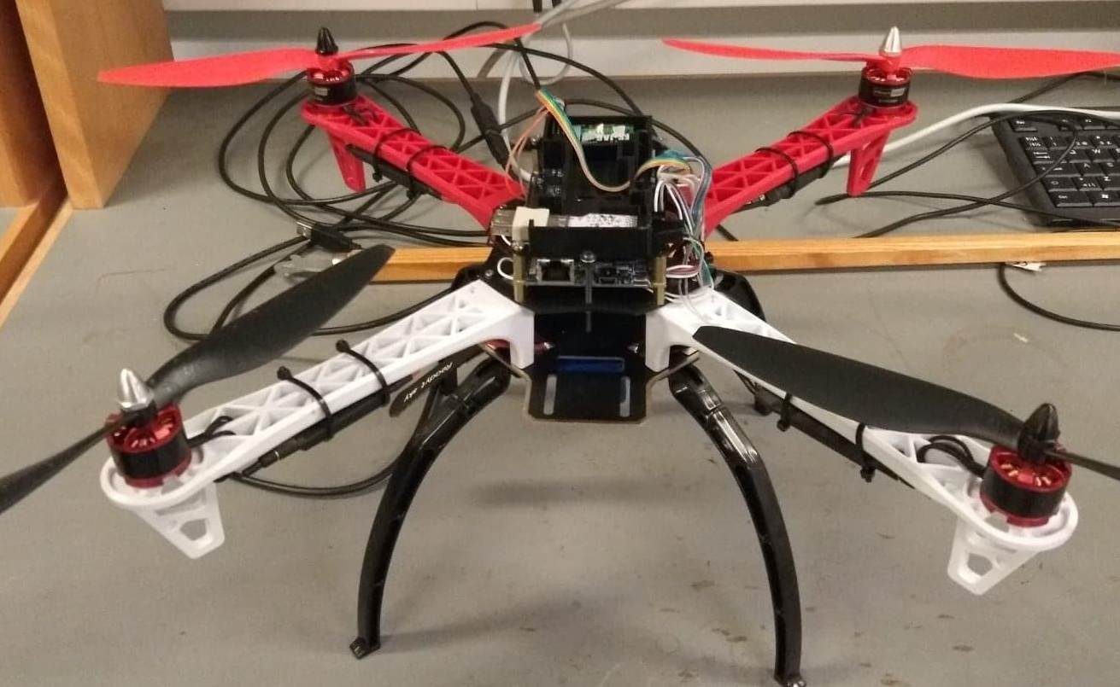
Timeline - overview (from last time)
July - December
Hardware design for both models.
Flight controller development on Arduino.
Manual flight controller development on single core.
Implementing all sensors and actuators on Patmos.
Adding external libraries for GPS and Barometer.
Communication types: I2C, UART, PWM,...
Developing separate applications for testing.
Assembling drones.
First versions for the PCB, cover and additional parts for fitting the board inside the body.
PID tuning and stabilisation tests working on a single core.
Handover
Meeting
today
Introduction
to Predict @DTU
COVID 19
Status Meeting
21/11/2020
Mar. | Apr. | May | Jun. | Jul. | Aug. | Sept. | Oct. | Nov. | Dec. | Jan. | Feb. | Mar. | Apr.
2020
2021
Notes:
Including this from last time for the sake of completeness

Slide 4
Timeline - updated
January
Multicore troubleshooting
Pin assignment issues
Restructuring FC to fit multicore setup
PCB designing and printing
Designing covers
March
Converting FC to fixed point continued - finished
Tuning PID with multicore setup, cover on, fixed point
Testing PCB
Building additional drones
Documentation
April
Fine-tuning PID controllers
Barometer implementation
Testing newly build drones
Documentation
February
Converting FC to multicore continued
Printing & testing covers
Printing & testing PCB-s
Converting floating point calculations to fixed point
Handover
Meeting
today
Introduction
to Predict @DTU
COVID 19
Mar. | Apr. | May | Jun. | Jul. | Aug. | Sept. | Oct. | Nov. | Dec. | Jan. | Feb. | Mar. | Apr.
2020
2021
Notes:
Including this from last time for the sake of completeness

Slide 5
Objectives
Design a physical drone using an FPGA as flight controller, that integrates different components required for an autonomous flight.
Design a flight controller for the Patmos architecture that handles the different components through the different features provided by Patmos.
The designed drone should be able to take off, fly and land.
The designed drone should be capable of hovering at a constant altitude and maintain its position.
The design should be scalable, i.e. it is modular and can be easily replicable.

Slide 6
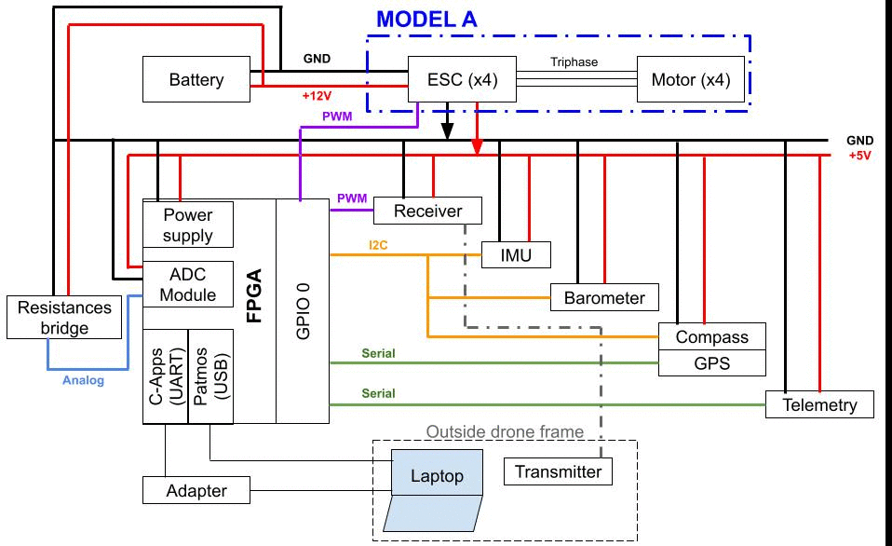
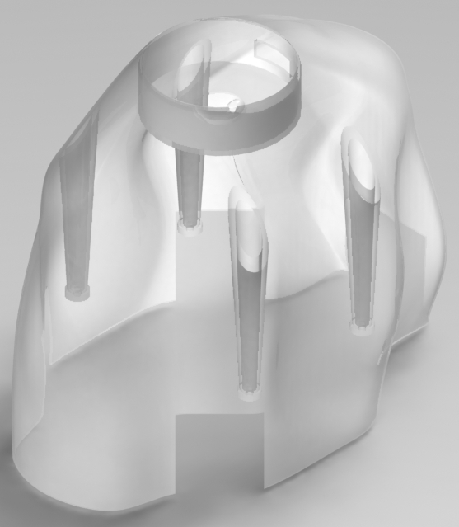
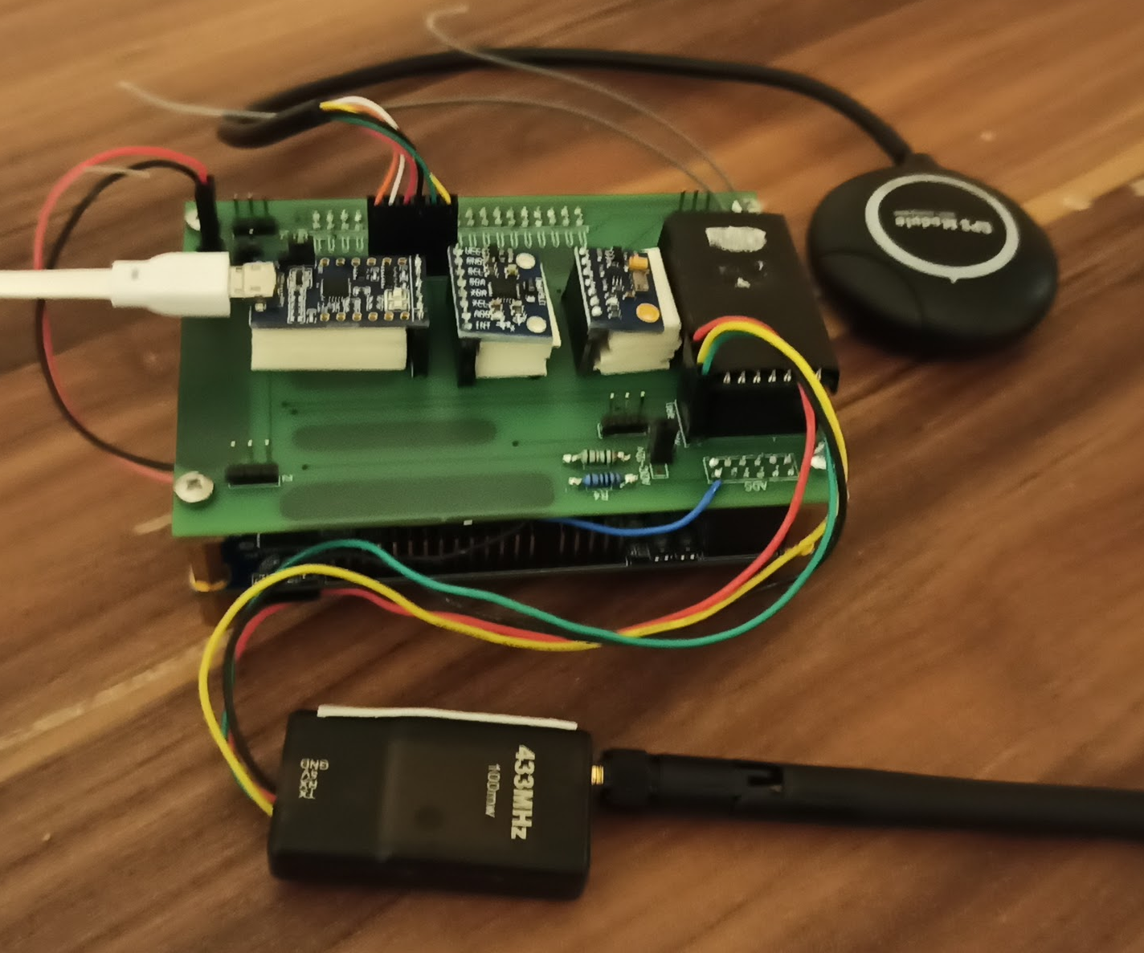
Hardware design
Electrical and electronics design
Two drone models have been designed (A and B).
For both models are used the same frame, sensors and custom parts. Differences: the motors and a power module.
Custom parts: PCB, drone cover and attachment parts for assembly.

Slide 7
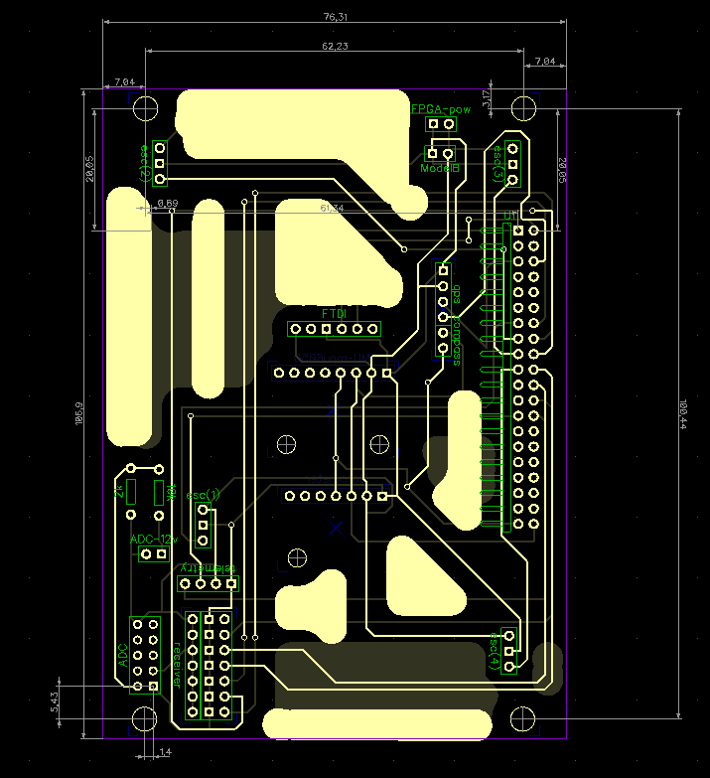
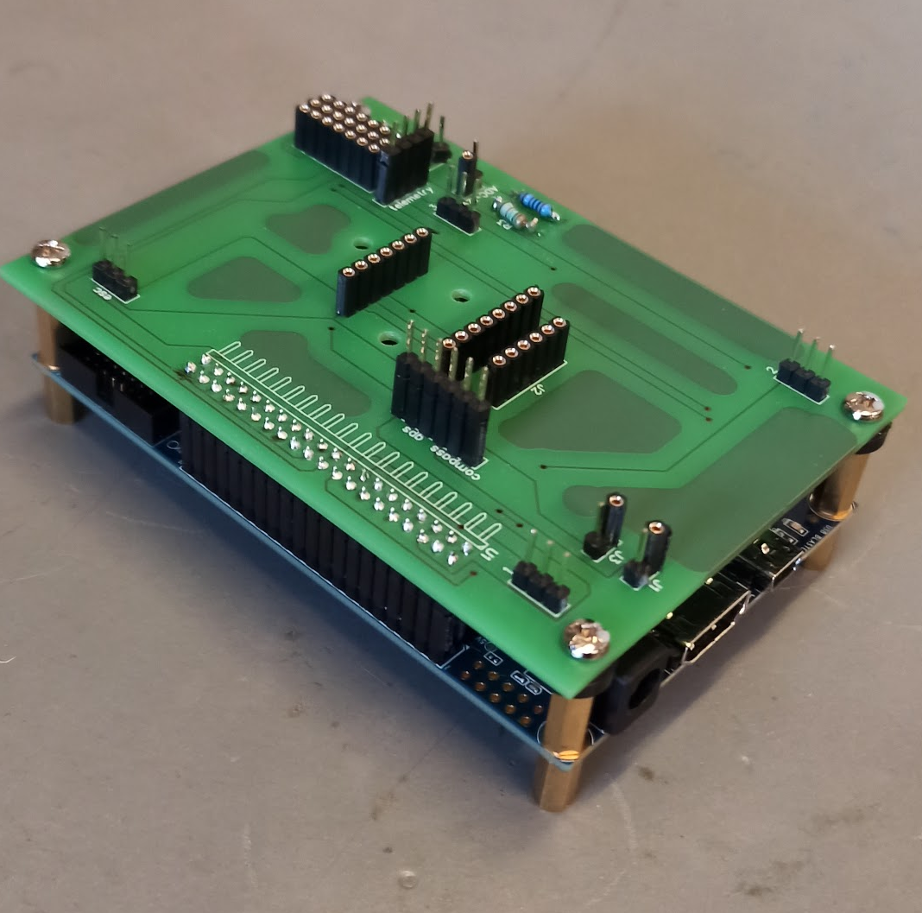
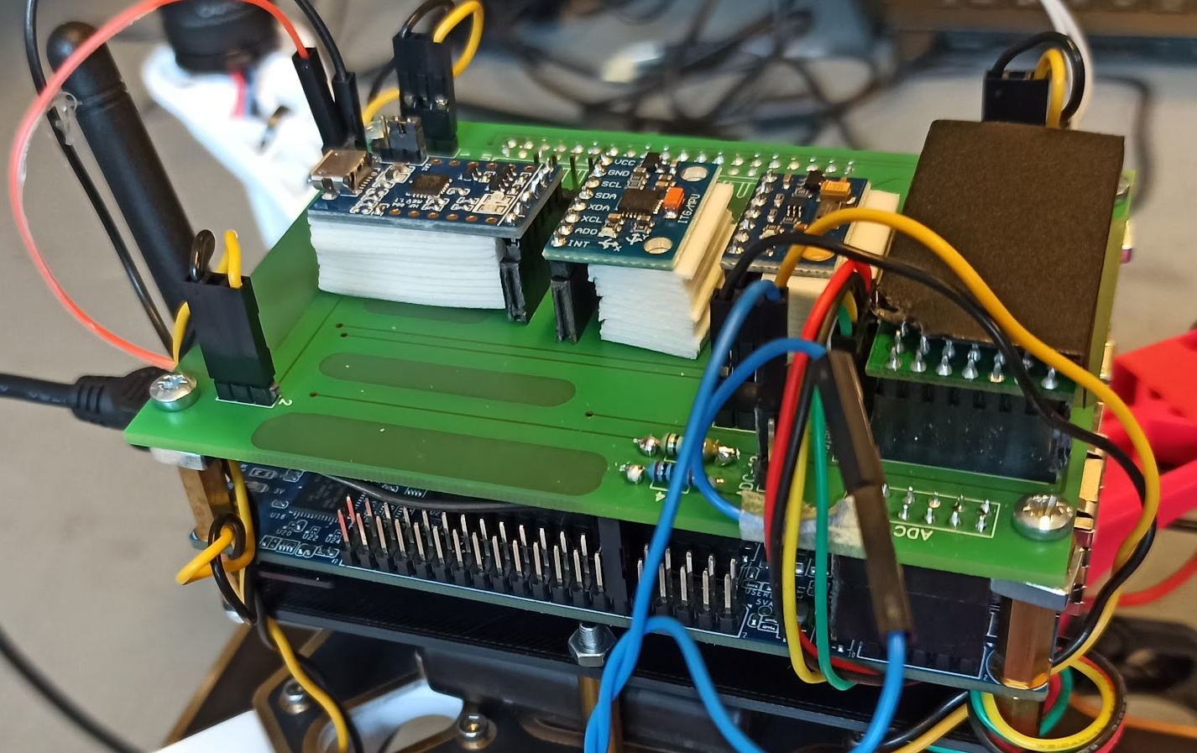
Hardware design
Printed Circuit Board (PCB)
The PCB model was designed as a shield which can be mounted on top on de10-nano.
This PCB can be used for both model A and B with the only difference being that the 5V power to the FPGA for model B comes to the Model B pin on the PCB

Slide 8
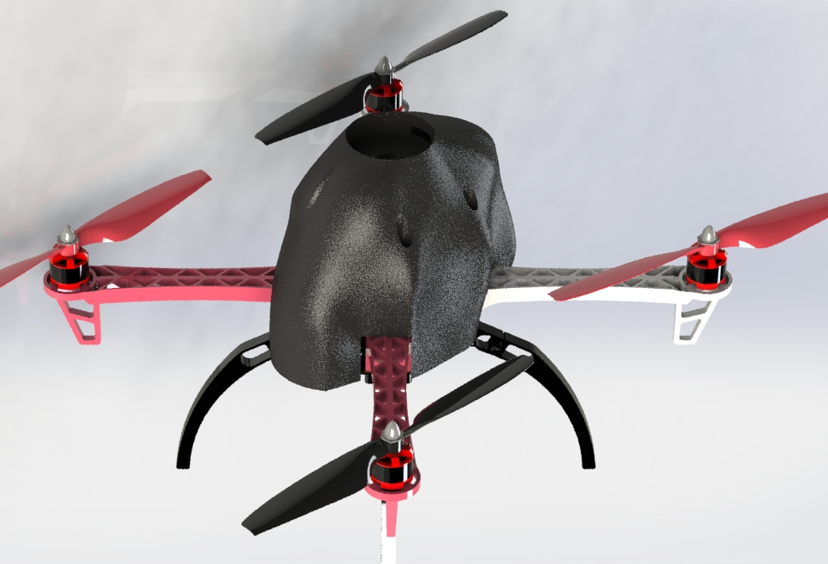
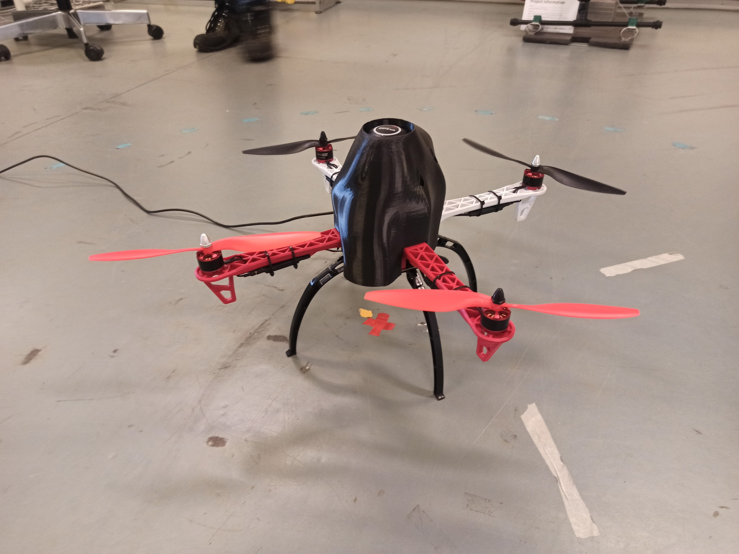
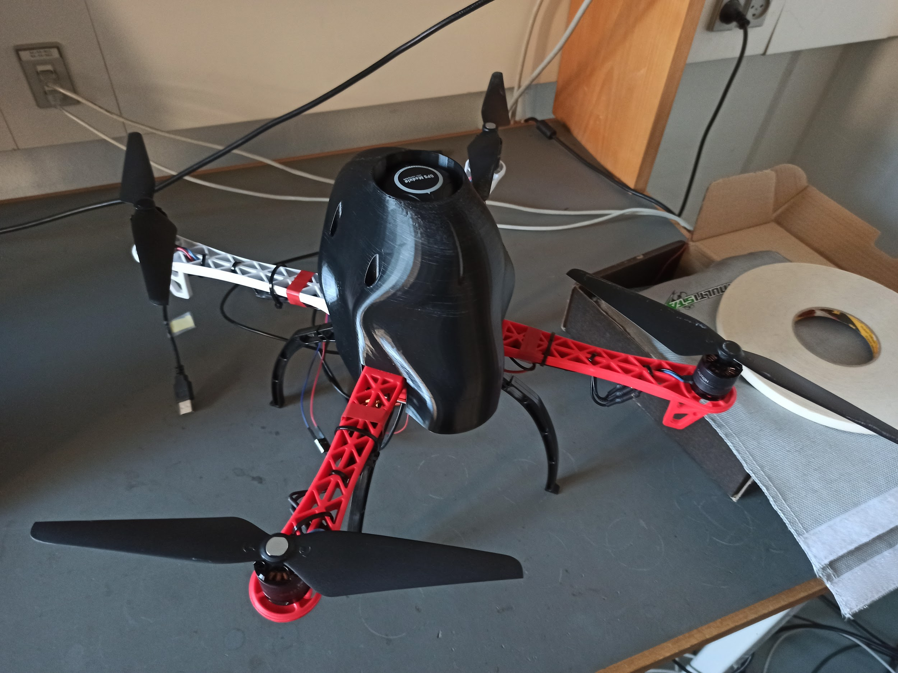
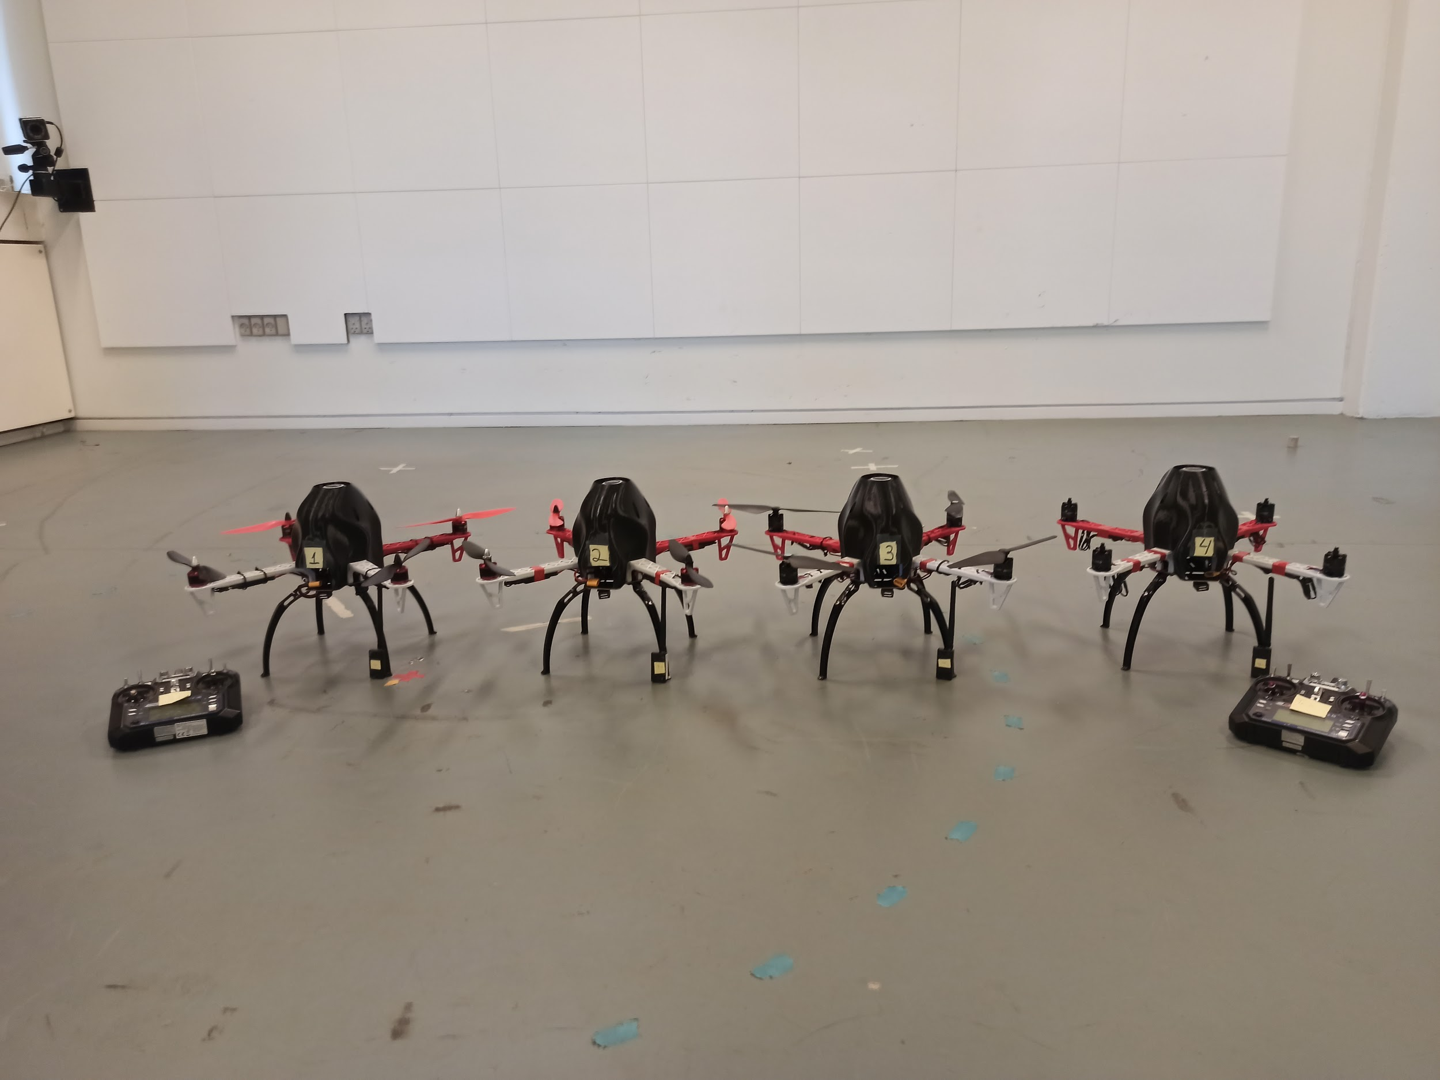
Hardware design
Cover design and assembly

Slide 9
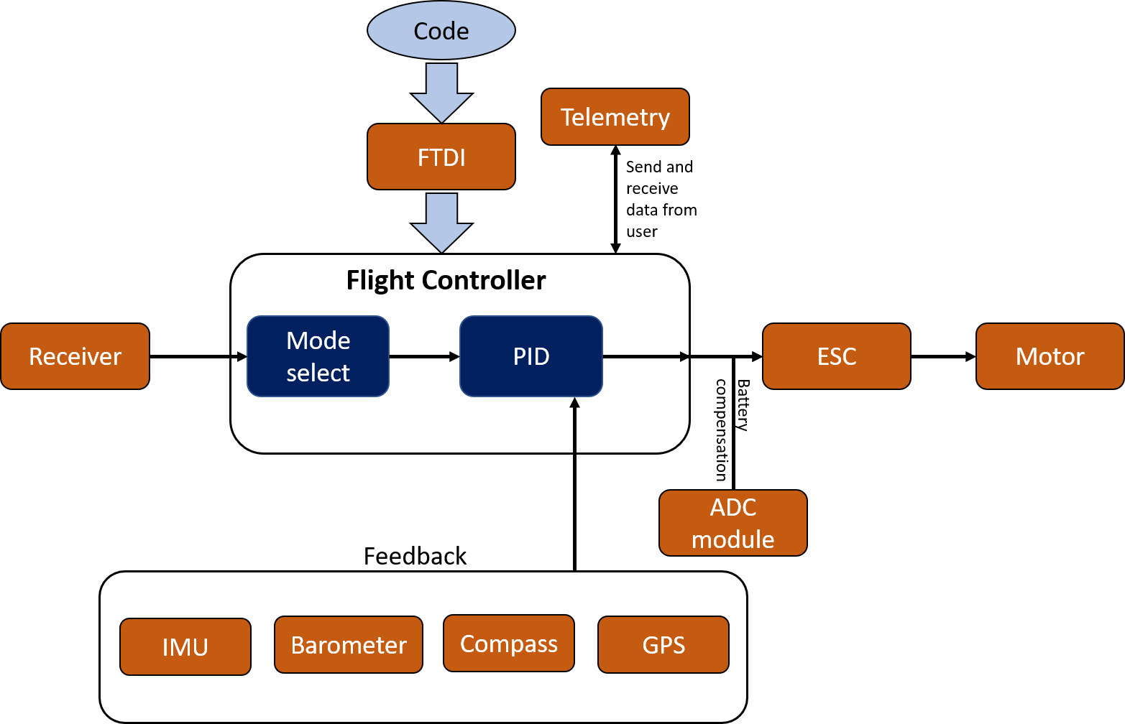
Final software design
Flight Controller design
The code is uploaded using FTDI
The telemetry is used to send and receive commands from the user wirelessly.
The ADC module is used for battery compensation for the motors.
The mode of the flight is chosen from the channel 5 of the receiver, which are:
Manual mode
Altitude hold
Position hold
Return to home

Slide 10
Final software design
Flight Controller design
The Flight controller takes in the reference signal from the receiver and takes the feedback from the sensor data from IMU,compass, GPS and Barometer. It then calculates the required motor signals and send it to the ESC.

Slide 11
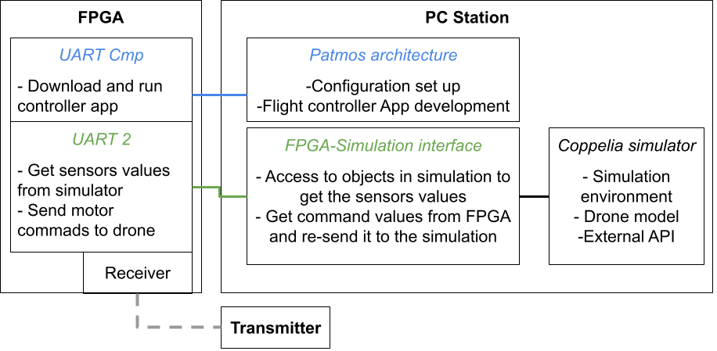
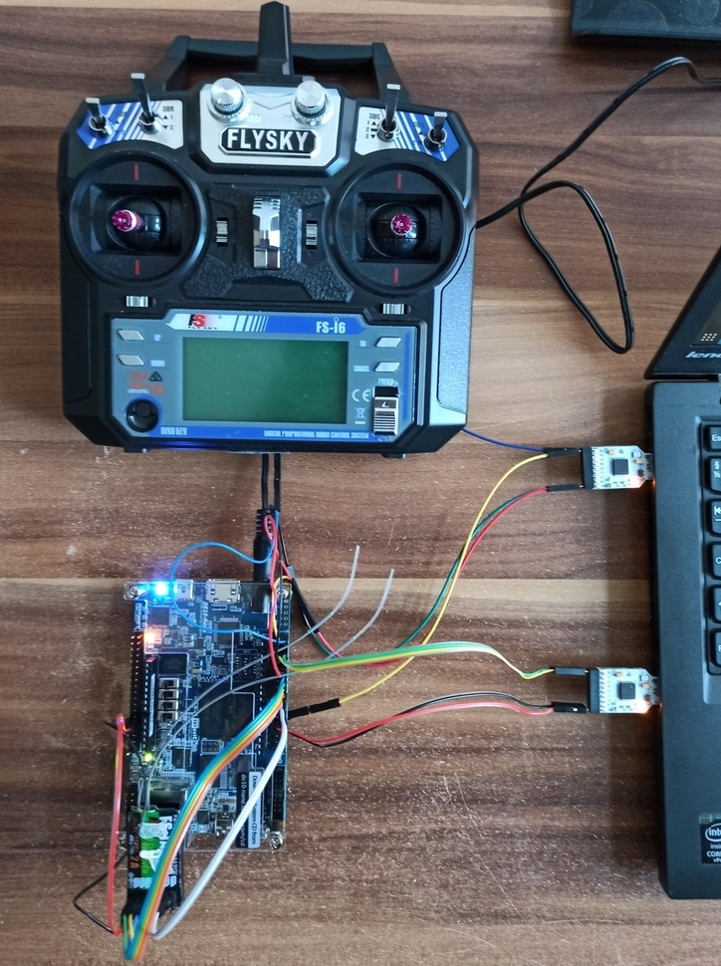
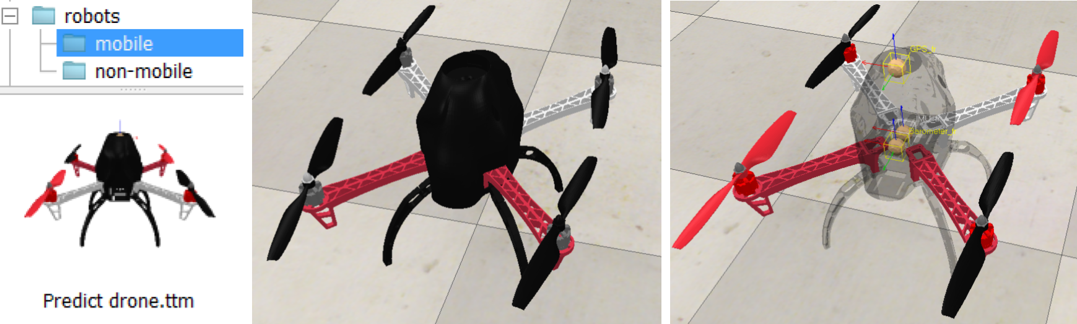
Simulation
Simulation concept using CoppeliaSim

Slide 12
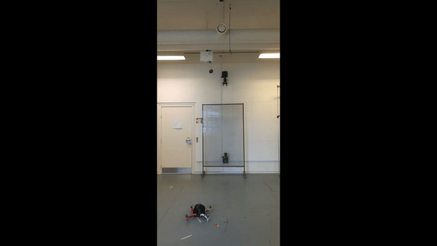
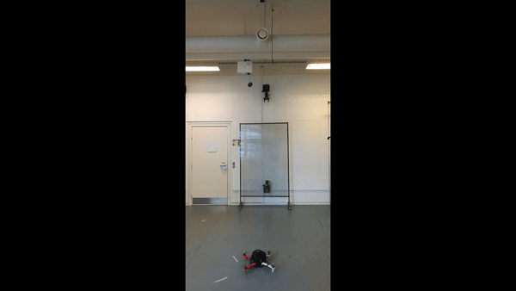
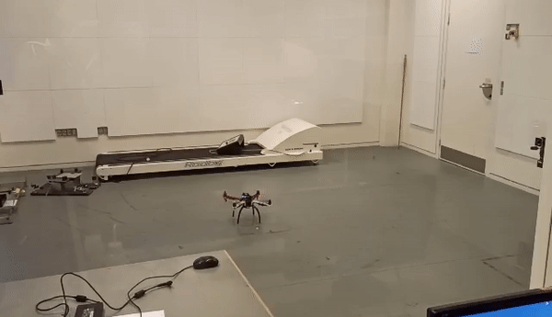
Demo

Slide 13
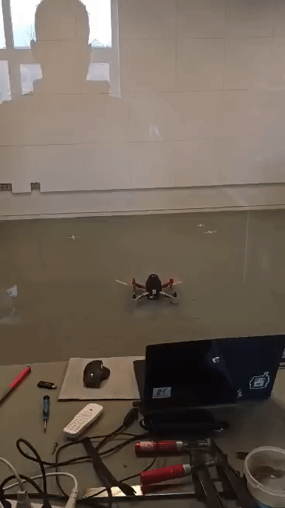
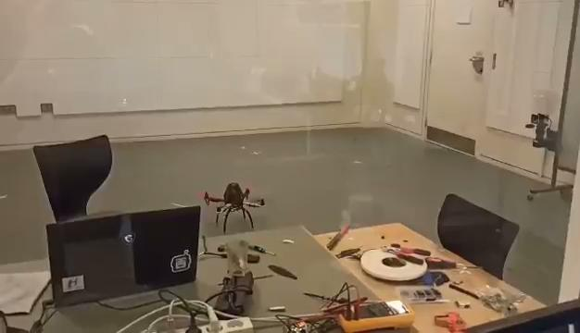
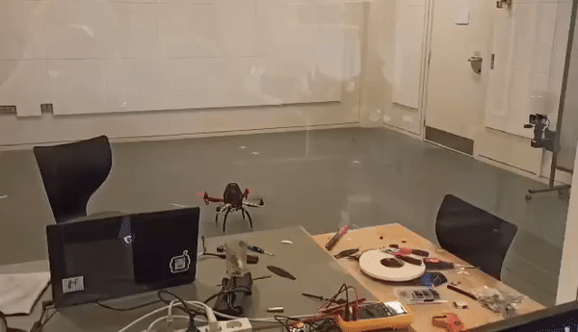
Demo

Slide 14
Summary
Current implementation running at a maximum of 50Hz
Software distributed over three cores
main core: Flight controller code
1st core: I²C communication (IMU, Barometer and Compass)
2nd core: Radio control (Transmitter / Receiver)
Barometer fully implemented, but PID not tuned
Uses only IMU, and compass sensor data

Slide 15
Conclusion
Done
Four drones built with all the necessary sensor and components.
A flight controller with Patmos multicore architecture.
A drone which can be manually controlled to take-off and fly.
The design is easily replicated and can be reused.
To-do
Control of the drone and landing can be improved by fine tuning the PID gains.
Functionalities for altitude and position hold is not implemented, due to time constraints and core 3 problems.
Drone simulation is unfinished due to modelling difficulties.

